Slide 1
Digital Portfolio
STUDENT NAME:
REGISTER NO AND NMID:
DEPARTMENT:
COLLEGE: COLLEGE/ UNIVERSITY
G. Mahalakshmi
24134031802522024
BSC- ll year
:
PSPT MGR GOVT ART AND SCIENCE COLLEGE

Slide 2
PROJECT TITLE
Chatbot development :
• This project highlights the design and implementation of AI-powered chatbots language understanding and interactive conversation capabilities
• The work emphasized practical application of AI in real work scenarios support, education, and personal assistance

Slide 3


AGENDA
Problem Statement
Project Overview
End Users
Tools and Technologies
Portfolio design and Layout
Features and Functionality
Results and Screenshots
Conclusion
Github Link
3/21/2024 Annual Review

Slide 4

PROBLEM STATEMENT
• Define the gap your chatbot solves (e, g. Costomer support automation, learning assistant, portfolio demo)
• There is a need for an intelligent, conversational interface that can understand used queries, provide instant response and operate 24/7

Slide 5

PROJECT OVERVIEW
• Project overview : chatbot development
•project Title : chatbot development
G. Mahalakshmi Bsc student
•This project showcase the devolpment of an AJ powered chatbot capable of handling natural conversation

Slide 6

WHO ARE THE END USERS?
• customer looking for instant support
• Business seeking cost Effective automation
•student and learners Who want a Virtual tutor
•Developers exploring AJ driver conversational system

Slide 7

TOOLS AND TECHNIQUES
• languages : Python, JavaScript, etc
•Framework : Rasa, Dialoflow, langchain, or custom NLP
•Hosting :Heroku, aws, github pages
•Any libraries /APJs integerated

Slide 8
POTFOLIO DESIGN AND LAYOUT
• How you present the chatbot (web, interface, UJ, integration in portfolio site).
•visuals and interaction flow
8

Slide 9
FEATURES AND FUNCTIONALITY
•core functions ( conversation,Q&A, tast automation
•special features ( memory, personality multi-languages, APJ calls

Slide 10

RESULTS AND SCREENSHOTS
• Testing result : chatbot successful answered >85% of queries in testing
• user feedback : projective response for usability and quick replies
• screenshot : [ insert sample chatbox conversation screenshot here ]
3/21/2024 Annual Review
10

Slide 11
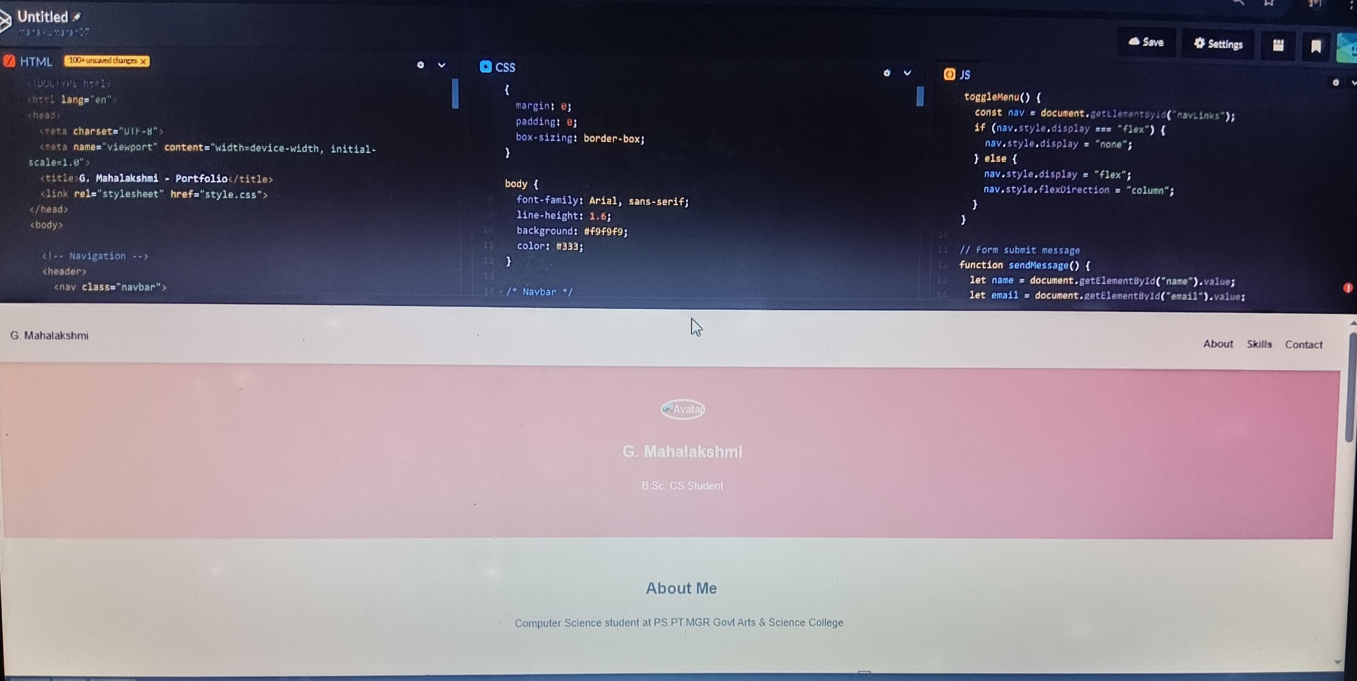
Screenshot :

Slide 12
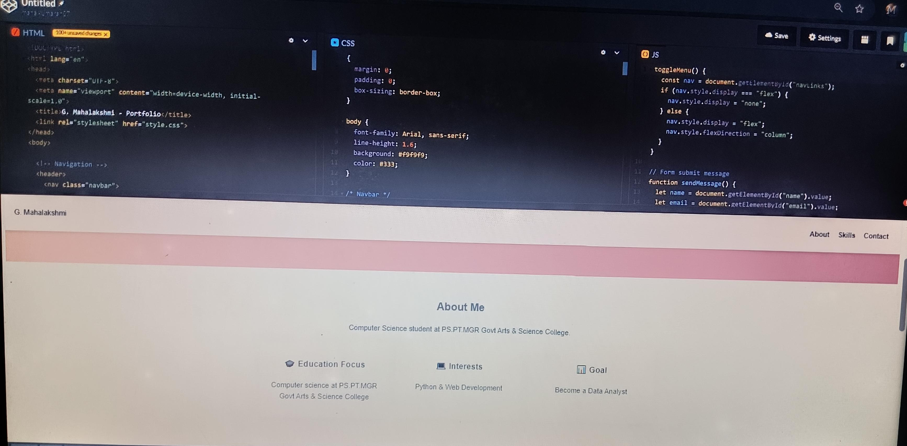

Slide 13
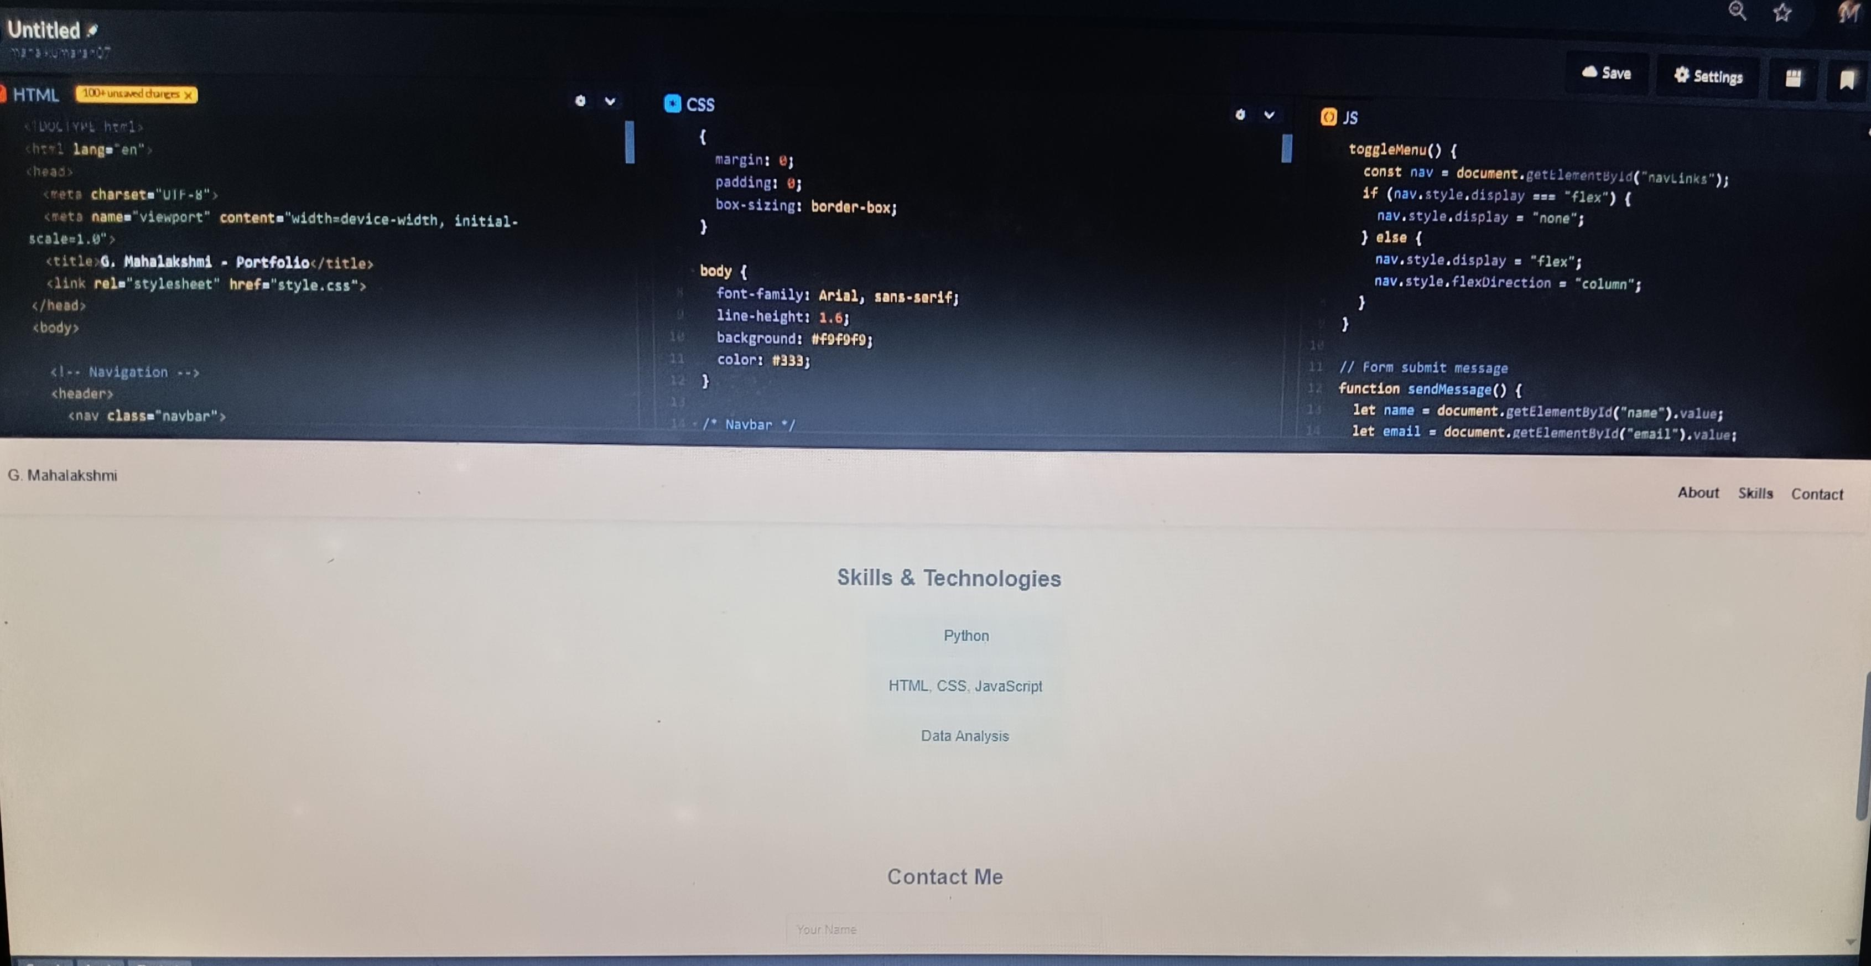

Slide 14
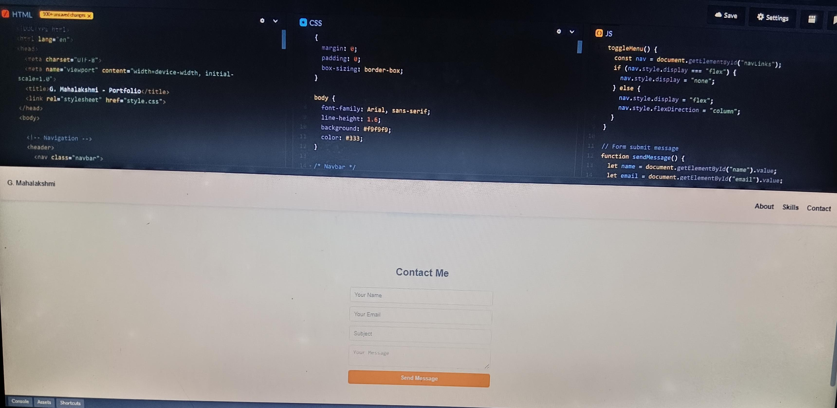

Slide 15
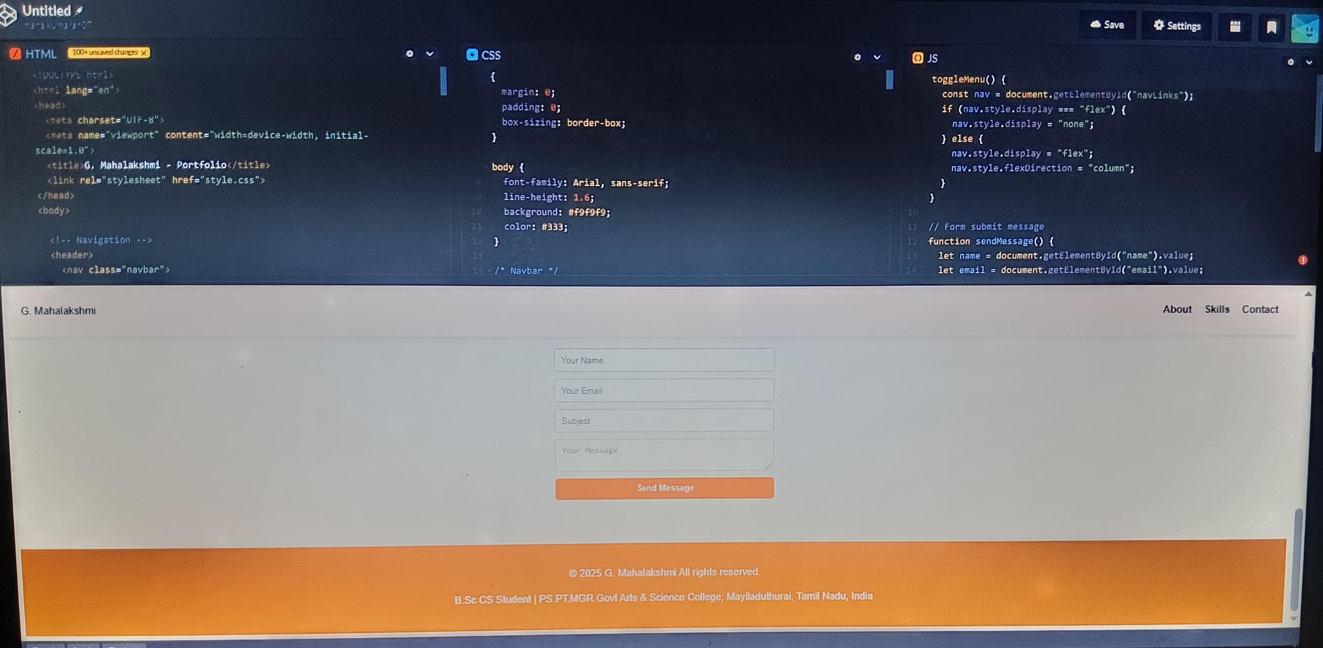

Slide 16
Conclusion
The chatbot demonstrate how AI driver conversational agent can improve user experience reduce workload on human agents and provides scalable solution across Industries

Slide 17
GitHub Link
•share repo for transparency and credibility

